Slide 1
EURAXESS Talent Circulation Hub
FSTP Call Info Session
SAIA, n. o.
December 12, 2023
The ERA TALENT project has received funding from the European Union’s Horizon Europe research and innovation programme under grant agreement No 101103476

Slide 2
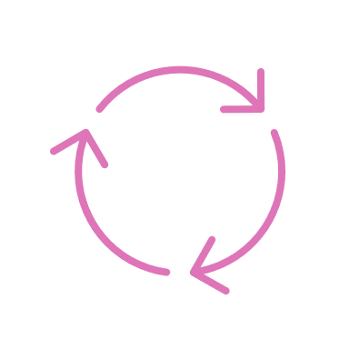
5 Thematic cross-border Hubs
Euraxess Startup Hub
Hubs are defined as integrated platforms for thematic cross-border collaboration of EURAXESS service centres (ESCs) and other stakeholders, outside of the EURAXESS network, in engaging and providing services to researchers, research organisations and other ESCs.
Research Career Beyond Academia
Research Careers in Academia
EURAXESS Talent Circulation Hub
Euraxess Science 4 Refugees Hub

Slide 3
Why Talent Circulation Hub?
Newly founded EURAXESS hub focusing on mobility and relocation support to facilitate attracting, welcoming, integrating and retaining of researchers in ERA.
What is the added value?
Further advancing services related to international mobility
Developing activities towards alumni and diaspora researchers
Exploring how EURAXESS can be more active in shaping talent circulation strategies
Strengthening the role of EURAXESS in developing policies and promoting ERA

Slide 4
How is the Talent Circulation Hub structured
Core Coordination Group
Hub members
Wider EURAXESS community
Coordinate activities of the Hub
Contribute to Hub activities
Participate in knowledge sharing
SAIA, University of Sofia, CERTH, ETAG, DLR, OEAD, NUFFIC, NAWA, Bizkaia Talent
Contribute to activities of the Hub (develop new services, establish collaborations, test new approaches, create content..)
Participate in knowledge sharing
Connected to Hub through Communities of Practice (Talent Circulation CoP, Supporting mobility and procedures, including entry conditions, social security, and taxation CoP, Social integration and dual careers CoP)
Participate in knowledge sharing

Slide 5
Who should join the Hub?
Centres providing or with an ambition of providing advanced services for international researchers and their families
Centres that want to develop collaborations with other EURAXESS members as well as stakeholders outside EURAXESS network
Centres that are or want to be active in development and implementation of talent circulation strategies at different levels
or
or

Slide 6
Steps to creation of Hub
Piloting advanced
services and activities
Collecting the Hub
related knowledge and information
Developing
the Hub Toolkit (ERA Talent platform for institutions)
Developing
collaborations with external stakeholders
Outreach towards
wider EURAXESS network (through CoPs and other channels)

Slide 7
Examples of activities (part I)
Service development
Networking events
Novel activities deepening or extending existing services to support relocation of international researchers and their partners and families
Improving institutional management of those services (online tools, service models).
Events organized to support integration of international researchers and their families.

Slide 8
Examples of activities (part II)
Connecting to diaspora and alumni researchers
Cross-border EURAXESS collaborations
Workshops, promotional events and other activities to connect to alumni researchers abroad or researcher’s diaspora communities abroad.
Joint activities (events, common information materials etc.) organized in collaboration with other EURAXESS centers

Slide 9
Examples of activities (part III)
Collaborations beyond EURAXESS
Supporting brain circulation strategies
Workshops and other activities to develop collaborations with local/regional actors with an aim to facilitate integration of international researchers.
Contributing to developing regional/local/institutional brain circulation strategies (consultations, round tables, co-creation workshops etc.).

Slide 10
Examples of activities (part IV)
Surveys and mapping exercises
Staff trainings
Surveys and mapping exercises to explore push and pull factors for researcher´s mobility.
Exercises to map regional policies and measures to attract and retain research talents and identify relevant stakeholders
Workshops, trainings, networking events and other activities to support institutions in strengthening or building novel recruitment strategies
Study Visits (hosting group study visits and participating in individual or group study visits)

Slide 11
Related activities in the Era Talent Project
Identifying examples of activities, initiatives and strategies to support talent circulation (to be carried out in T 6.3.3)
Preparing and running the survey focusing on push and pull factors researchers face when entering ERA (to be carried out in T 6.3.2)
Mapping across EURAXESS network of already established activities facilitating social integration of researchers and their partners (already carrried out in T 5.2.2)
Organising networking events to support social integration of researchers and their families (to be carried out in T 5.2.2)
Developing the Hub Toolkit (ERA Talent platform for institutions – T 6.4.2)

Slide 12
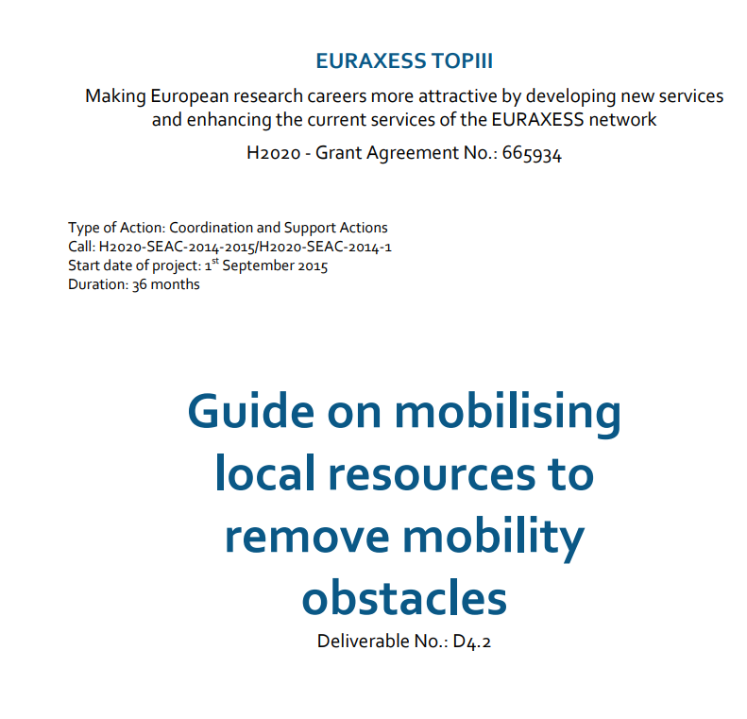
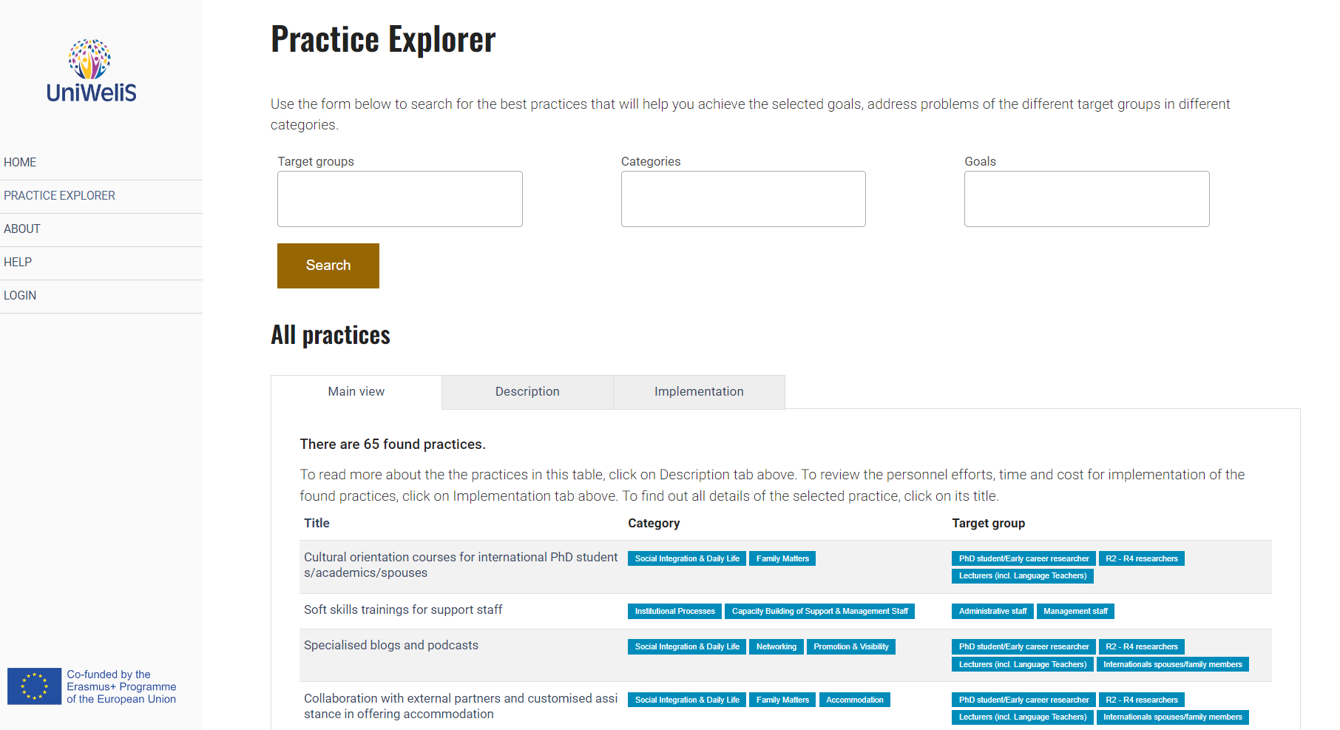
Building upon the earlier activities
https://app.uniwelis.saia.sk/practice
Available in Extranet Library

Slide 13
Thank you for your attention!
Questions?
karla.zimanova@saia.sk
janka.kottulova@saia.sk

