Slide 1
EURAXESS Science4Refugees Hub Information Session
Cascade Funding Call, ERA Talent Project,
online, 14 Dec 2023
Svetlana Dimitrova, Project Manager, Sofia University
BHO EURAXESS Bulgaria

Slide 2
What to expect from this session?
Who we are? – short introduction of the participants:
Why you joined this session?
Your organisation,
Motivation to apply for this hub,
Activities that you plan (very general)
The hub team – short presentation of the core team of the hub
The S4R Hub background & future online toolkit
The S4R Hub plan – ideas on activities that you may include in your proposals
Support and contact

Slide 3
The hub team
Hub leader information
Name of the institution | Contact person
Sofia University, Bulgaria | Svetlana Dimitrova
Core group members
Name of the institution | Contact person
1. CERTH, Greece | Dimitris Sanopoulos
2. ETH, Switserland | Seraina Munton-Keller
3. OeAD, Austria | Martina Laffer
4. UGOT, Sweden | Ravaka Ramanamisata
5. NAWA, Poland | Anna Wiśniewska
6. UEFISCDI, Romania | Elena Ionescu
7. SAIA, Slovakia | Janka Kottulova
8. LZP, Lithuania | Darja Aksjonova
9. ETAg, Estonia | Siiri Kolka
10. SIPAC, Armeia | Tigran ARZUMANYAN
11. UCA, France | Julie CARDINAUX

Slide 4
The S4R Hub
The S4R Hub activities will interconnect with other hubs and stakeholders in order to reach the synergy in finding jobs and funding within and outside academia.
Main impact - better availability and quality of services to enable faster integration of refugee researchers in the labour market through the organisational, national and EU programs.
By this the hub will contribute to the European economy with integration of displaced researchers and their families.
The hub activities will concentrate specific effort to female displaced researchers and their spouses.

Slide 5
The S4R Hub background
BRiDGE projects catalysed the ways of the partners have collaborated in providing the cross-border services and the follow-up activities for refugee researchers. There was established a well working model of international cooperation for solving refugee researchers’ cases.
Current wave of Ukrainian refugee researchers
Expertise of the network in serving mobile researchers
*** Specifics of the target group

Slide 6
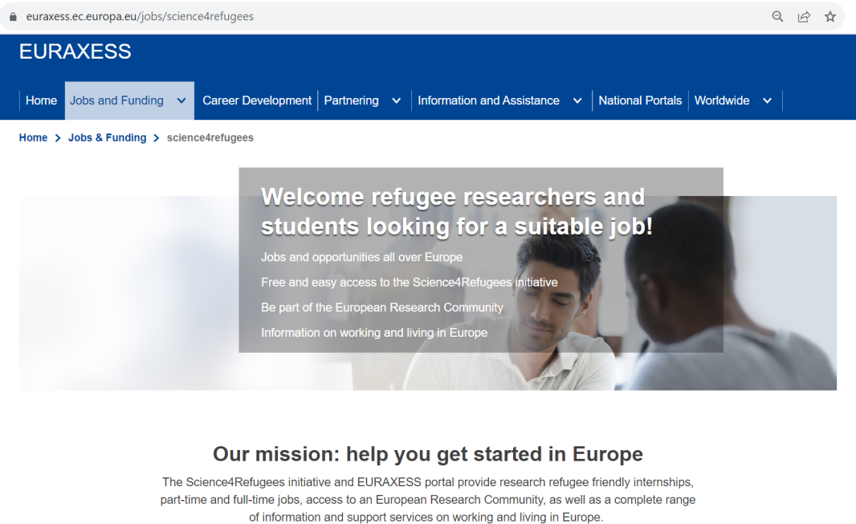
S4R Hub future online toolkit
What about EXTRANET?

Slide 7
The S4R Hub plan – ideas on activities that you may include in your proposals
Promote the hub and its activities as widely as possible,
Promote the paid Internship program for refugee researchers (starts Jan 2024)
Ensure participation of as many as possible refugee researchers in the relevant network activities,
Collect several testimonials of solving cases through the hub service,
Describe the good practice examples to be used for training the staff,
Offering at least 1 group study visit for EURAXESS members.
Train as many as possible refugee researchers on how best to use the network tools, materials and services in order to integrate themselves in the labour market,

Slide 8
The S4R Hub plan – ideas on activities that you may include in your proposals
Inform and discuss with organisations how to arrange hosting of a refugee researcher through the network service and integrate him/her in the organisational culture,
Establish new type of service/ for the refugee researchers on hub level – psychological support, socialising support, etc.
Establish stable connections with the refugee formal and informal groups and organisations,
Continue stable cooperation with organisations working with refugee researchers – SAR Europe, Science for Ukraine, NGOs, etc.
Arrange a policy discussion with recommendations

Slide 9
THANK YOU!
Supporting your application
Call page on ERA Talent Coordinator APRE website https://www.euraxess.it/italy/news/era-talent-call-multiplying-impact-euraxess-hubs
Guide for Applicants, templates, application form, budget, etc.
Technical support for application
https://www.youtube.com/watch?v=8jxFYgH7xwM
https://www.euraxess.hu/hungary/events/info-session-era-talent-call-multiplying-impact-euraxess-hubs
You can contact us at any time for advice and discussing your plans – svetlana@fmi.uni-sofia.bg

