Slide 1

EURAXESS Startup Hub
Financial support to third parties (FSTP) call
Milan Zdravković

Slide 2
What is a EURAXESS hub?
Network of EURAXESS members experienced or committed to working in one of the following thematic areas..
  Socio-cultural integration of researchers and their families
  Talent management
  Careers beyond academia
  Scientific startup entrepreneurship
  Assisting researchers among refugees
.. while also engaging external stakeholders, with knowledge, experience and skills, relevant to the selected thematic area,..
.. implementing local and collaborative (cross-organizational) initiatives, contributing to improving the state of play in the selected thematic area.

Slide 3
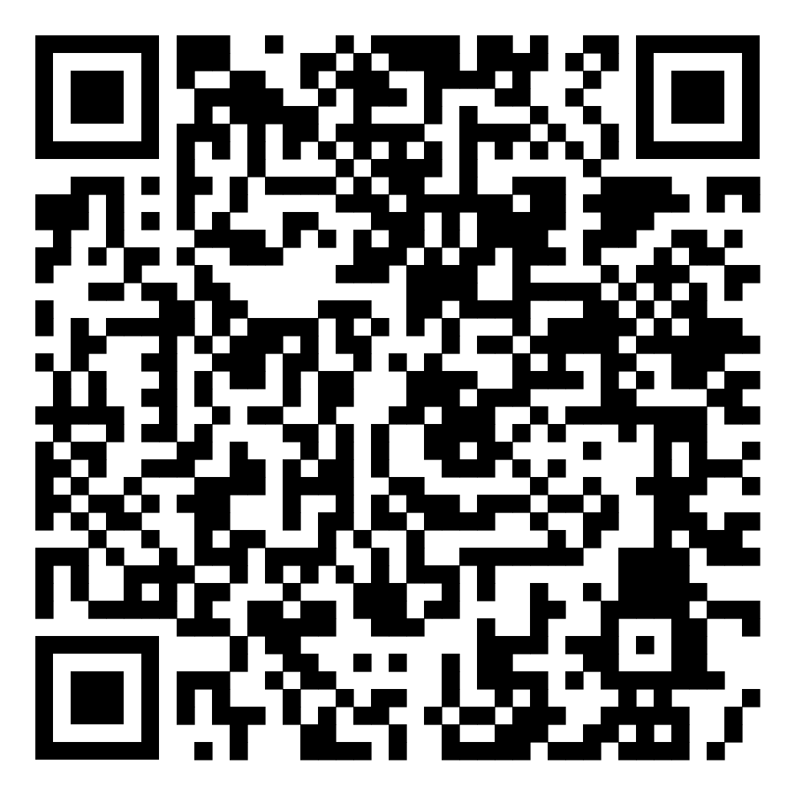
EURAXESS Startup Hub
Established as a pilot in 2022, 7 EURAXESS BHO organizations (IL, EE, CY, LU, RS, BA, ME)
Pilot activities
  EURAXESS Startup Tour
  Two webinars for EURAXESS members
  Digital toolkit
  Local activities
https://www.euraxess.rs/serbia/euraxess-startup-hub

Slide 4
EURAXESS Startup Hub in ERA Talent project
3.3 Hubs workplans preparation and evaluation (CERTH)
Call criteria
1.3 Management of third parties (BZN)
Recruiting hosts
4.2.1. Study visits and newcomer integration (SAIA)
5.1.4 Start up Academy (IPD)
Recruiting participants
4.2.2. Stakeholder events (BZN)
5.2.4 Startup Tour II (MEF)
Info day and workshop
4.3.1. Events on hubs (SU)
2.2.1 Smart Talks Podcast (IPD)
Content, programme
4.3.3. Biannual Conference (BZN)
Feedback
4.1. Communities of Practice (ETAG)
Promotion and dissemination tools

Slide 5
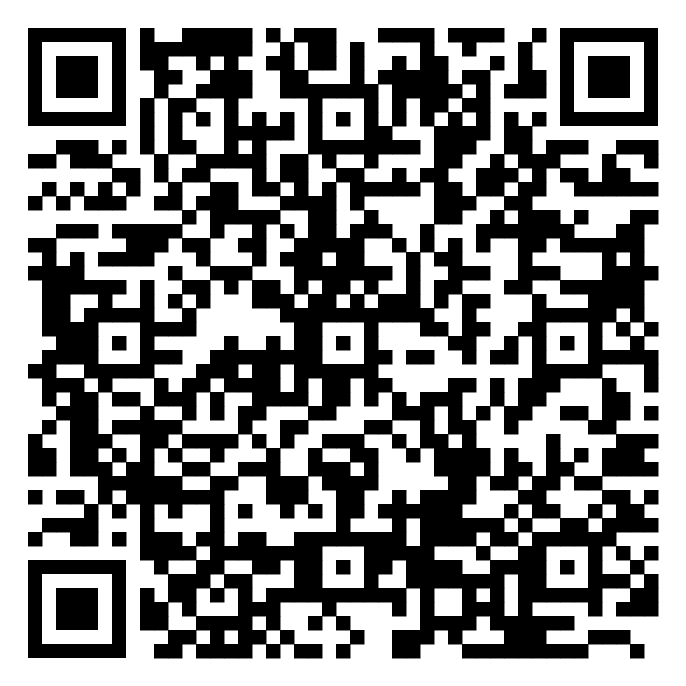
EURAXESS Startup Hub Entrepreneur Leadership Academy
From Pitch to Profit: Communication Skills and Technical Strategies to Raise Capital for your Startup (IPD, June 2023)
Discovery and Validation with Scientific Method: the Lean Startup Approach (MEF, Nov 2023)
Conceptualize Your Deep Tech Startup Idea: Learn Your Way Through AI State of the Art (MEF, Feb 2024)
Teamwork in a Startup: Team Building, Managing Talent (ETAG, Apr 2024)
Creativity in Problem-Solving and Decision-Making (FCT, Oct 2024)
Receiving Feedback & Pivoting in a Startup, How to Grow (RIF, Jan 2025)
Global Connections: Building Your Network and Branding Your Startup for Success in the Global Market (IPD, Mar 2025)
https://www.euraxess.rs/serbia/euraxess-startup-hub-academy

Slide 6
FSTP Call – we want you on board
Targeted actions with the aim of producing clear, short-term, qualitatively high impact that will help EURAXESS Startup Hub to build the recognition and reputation among researchers, as a credible scientific startup entrepreneurship support infrastructure
Widen the range and multiply the impact of your local activities by benefiting from access to an already established, strong international pool of expertise
Mandatory cross-organizational engagement (external stakeholders, international)
Mandatory promotion activities EURAXESS Startup Hub-branded

Slide 7
Examples of expected actions
Activity | Target groups | Description
Local EURAXESS Startup Hub Tour events | Researchers | Short learning experiences involving local researchers, with mandatory international dimension, through funded participation of small number of external trainers/researchers/EURAXESS staff
Online events offering learning experience | Researchers | Webinars to add to EURAXESS Startup Hub Leadership Academy series or online discussion/panel sessions, with exceptional trainers/participants, leaders in the European startup ecosystems, including testimonials. Industry leaders’ online talks.
Networking with funders | Researchers | For example, facilitating meetings between aspiring scientific entrepreneurs and VC (Venture Capital) firms
Online pitch competitions | Researchers | Competitions within the specific topics/challenges/industries, with small award budgets and highly credible jury committees, similar or even aligned to Falling Walls Lab, providing international visibility to the startup projects presented through the EURAXESS communication channels
Mentoring schemes | Researchers, EURAXESS CDC | Schemes offering one-time support to the selected researchers by renowned professionals, both in business and tech aspects of startup innovation. The support could consist of providing expert information on features of markets abroad/the prospective technology-market fit. Setting up a peer mentoring scheme could be another project to support the Startup Hub with.
Development of online support resources | Researchers | Developing and promoting original online tools for providing any kind of support to aspiring sci-entrepreneurs, at any stage of startup development.
Mapping resources | Researchers, EURAXESS CDC | Mapping support capacities and relevant expertise within the EURAXESS network. Mapping sources of funding and other means of support for scientific startups.
Ambassador programme | Researchers | Identifying ambassadors among sci-entrepreneurs from various disciplines across the EURAXESS network who would help creating online content for PhDs and postdocs interested in starting their venture in the same area/using same technologies/for the same purpose but different service offers, etc. who would be willing to serve as point of contact and answer questions on an individual base.

Slide 8
EURAXESS Startup Hub
Financial support to third parties (FSTP) call
Thank you
milan.zdravkovic@gmail.com

